Slide 1
SEQUENTIAL CIRCUIT DESIGN
3 BIT Up/Down COUNTER JK Flip Flop
LECTURE 9

Slide 2
STEPS FOR SEQUENTIAL CIRCUIT DESIGN
State Diagram
Next State Table
State Reduction And Assignment
Flip Flop Transition Table (FLIP FLOP Selection)
Simplification
Input/output Equations
Implementations of Equation(Logic Diagram)

Slide 3
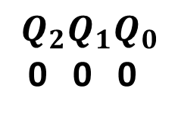
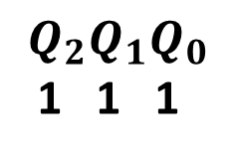
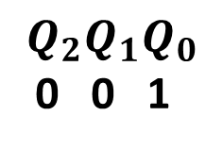
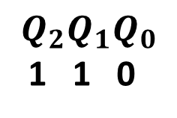
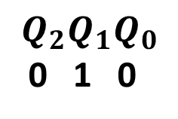
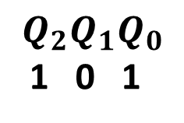
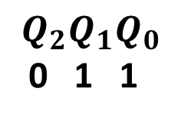
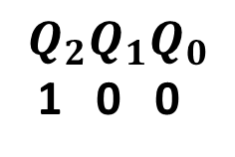
STATE DIAGRAM
X=1
X=1
X=0
X=0
X=1
X=1
X=0
X=0
X=0
X=0
X=1
X=1
X=0
X=0
X=1
X=1

Slide 4
STATE TABLE
INPUT | PRESENT STATE
X
0 | 0 | 0 | 0
0 | 0 | 0 | 1
0 | 0 | 1 | 0
0 | 0 | 1 | 1
0 | 1 | 0 | 0
0 | 1 | 0 | 1
0 | 1 | 1 | 0
0 | 1 | 1 | 1
1 | 0 | 0 | 0
1 | 0 | 0 | 1
1 | 0 | 1 | 0
1 | 0 | 1 | 1
1 | 1 | 0 | 0
1 | 1 | 0 | 1
1 | 1 | 1 | 0
1 | 1 | 1 | 1

Slide 5
NEXT STATE TABLE
PRESENT STATE |  |  | NEXT STATE |  |  | NEXT STATE
 |  |  | X=0 |  |  | X=1
0 | 0 | 0 | 0 | 0 | 1 | 1 | 1 | 1
0 | 0 | 1 | 0 | 1 | 0 | 0 | 0 | 0
0 | 1 | 0 | 0 | 1 | 1 | 0 | 0 | 1
0 | 1 | 1 | 1 | 0 | 0 | 0 | 1 | 0
1 | 0 | 0 | 1 | 0 | 1 | 0 | 1 | 1
1 | 0 | 1 | 1 | 1 | 0 | 1 | 0 | 0
1 | 1 | 0 | 1 | 1 | 1 | 1 | 0 | 1
1 | 1 | 1 | 0 | 0 | 0 | 1 | 1 | 0

Slide 6
NEXT STATE TABLE USING JK FLIP FLOP for X=0
 |  | J | K
0 | 0 | 0 | X
0 | 1 | 1 | X
1 | 0 | X | 1
1 | 1 | X | 0
PRESENT STATE |  |  | NEXT STATE |  |  | NEXT STATE |  |  | JK FLIP FLOP INPUTS |  |  |  |  |  | JK FLIP FLOP INPUTS
 |  |  | X=0 |  |  | X=1 |  |  | X=0 |  |  |  |  |  | X=1
0 | 0 | 0 | 0 | 0 | 1 | 1 | 1 | 1 | 0 | X | 0 | X
0 | 0 | 1 | 0 | 1 | 0 | 0 | 0 | 0 | 0 | X
0 | 1 | 0 | 0 | 1 | 1 | 0 | 0 | 1 | 0 | X
0 | 1 | 1 | 1 | 0 | 0 | 0 | 1 | 0
1 | 0 | 0 | 1 | 0 | 1 | 0 | 1 | 1 |  |  | 0 | X
1 | 0 | 1 | 1 | 1 | 0 | 1 | 0 | 0
1 | 1 | 0 | 1 | 1 | 1 | 1 | 0 | 1
1 | 1 | 1 | 0 | 0 | 0 | 1 | 1 | 0

Slide 7
NEXT STATE TABLE USING JK FLIP FLOP for X=0
 |  | J | K
0 | 0 | 0 | X
0 | 1 | 1 | X
1 | 0 | X | 1
1 | 1 | X | 0
PRESENT STATE |  |  | NEXT STATE |  |  | NEXT STATE |  |  | JK FLIP FLOP INPUTS |  |  |  |  |  | JK FLIP FLOP INPUTS
 |  |  | X=0 |  |  | X=1 |  |  | X=0 |  |  |  |  |  | X=1
0 | 0 | 0 | 0 | 0 | 1 | 1 | 1 | 1 | 0 | X | 0 | X | 1 | X
0 | 0 | 1 | 0 | 1 | 0 | 0 | 0 | 0 | 0 | X | 1 | X
0 | 1 | 0 | 0 | 1 | 1 | 0 | 0 | 1 | 0 | X |  |  | 1 | X
0 | 1 | 1 | 1 | 0 | 0 | 0 | 1 | 0 | 1 | X
1 | 0 | 0 | 1 | 0 | 1 | 0 | 1 | 1 |  |  | 0 | X | 1 | X
1 | 0 | 1 | 1 | 1 | 0 | 1 | 0 | 0 |  |  | 1 | X
1 | 1 | 0 | 1 | 1 | 1 | 1 | 0 | 1 |  |  |  |  | 1 | X
1 | 1 | 1 | 0 | 0 | 0 | 1 | 1 | 0

Slide 8
NEXT STATE TABLE USING JK FLIP FLOP for X=0
 |  | J | K
0 | 0 | 0 | X
0 | 1 | 1 | X
1 | 0 | X | 1
1 | 1 | X | 0
PRESENT STATE |  |  | NEXT STATE |  |  | NEXT STATE |  |  | JK FLIP FLOP INPUTS |  |  |  |  |  | JK FLIP FLOP INPUTS
 |  |  | X=0 |  |  | X=1 |  |  | X=0 |  |  |  |  |  | X=1
0 | 0 | 0 | 0 | 0 | 1 | 1 | 1 | 1 | 0 | X | 0 | X | 1 | X
0 | 0 | 1 | 0 | 1 | 0 | 0 | 0 | 0 | 0 | X | 1 | X | X | 1
0 | 1 | 0 | 0 | 1 | 1 | 0 | 0 | 1 | 0 | X |  |  | 1 | X
0 | 1 | 1 | 1 | 0 | 0 | 0 | 1 | 0 | 1 | X | X | 1 | X | 1
1 | 0 | 0 | 1 | 0 | 1 | 0 | 1 | 1 |  |  | 0 | X | 1 | X
1 | 0 | 1 | 1 | 1 | 0 | 1 | 0 | 0 |  |  | 1 | X | X | 1
1 | 1 | 0 | 1 | 1 | 1 | 1 | 0 | 1 |  |  |  |  | 1 | X
1 | 1 | 1 | 0 | 0 | 0 | 1 | 1 | 0 | X | 1 | X | 1 | X | 1

Slide 9
NEXT STATE TABLE USING JK FLIP FLOP for X=0
 |  | J | K
0 | 0 | 0 | X
0 | 1 | 1 | X
1 | 0 | X | 1
1 | 1 | X | 0
PRESENT STATE |  |  | NEXT STATE |  |  | NEXT STATE |  |  | JK FLIP FLOP INPUTS |  |  |  |  |  | JK FLIP FLOP INPUTS
 |  |  | X=0 |  |  | X=1 |  |  | X=0 |  |  |  |  |  | X=1
0 | 0 | 0 | 0 | 0 | 1 | 1 | 1 | 1 | 0 | X | 0 | X | 1 | X
0 | 0 | 1 | 0 | 1 | 0 | 0 | 0 | 0 | 0 | X | 1 | X | X | 1
0 | 1 | 0 | 0 | 1 | 1 | 0 | 0 | 1 | 0 | X | X | 0 | 1 | X
0 | 1 | 1 | 1 | 0 | 0 | 0 | 1 | 0 | 1 | X | X | 1 | X | 1
1 | 0 | 0 | 1 | 0 | 1 | 0 | 1 | 1 | X | 0 | 0 | X | 1 | X
1 | 0 | 1 | 1 | 1 | 0 | 1 | 0 | 0 | X | 0 | 1 | X | X | 1
1 | 1 | 0 | 1 | 1 | 1 | 1 | 0 | 1 | X | 0 | X | 0 | 1 | X
1 | 1 | 1 | 0 | 0 | 0 | 1 | 1 | 0 | X | 1 | X | 1 | X | 1

Slide 10
NEXT STATE TABLE USING JK FLIP FLOP for X=1
 |  | J | K
0 | 0 | 0 | X
0 | 1 | 1 | X
1 | 0 | X | 1
1 | 1 | X | 0
PRESENT STATE |  |  | NEXT STATE |  |  | NEXT STATE |  |  | JK FLIP FLOP INPUTS |  |  |  |  |  | JK FLIP FLOP INPUTS
 |  |  | X=0 |  |  | X=1 |  |  | X=0 |  |  |  |  |  | X=1
0 | 0 | 0 | 0 | 0 | 1 | 1 | 1 | 1 | 0 | X | 0 | X | 1 | X
0 | 0 | 1 | 0 | 1 | 0 | 0 | 0 | 0 | 0 | X | 1 | X | X | 1 | 0 | X | 0 | X
0 | 1 | 0 | 0 | 1 | 1 | 0 | 0 | 1 | 0 | X | X | 0 | 1 | X | 0 | X
0 | 1 | 1 | 1 | 0 | 0 | 0 | 1 | 0 | 1 | X | X | 1 | X | 1 | 0 | X
1 | 0 | 0 | 1 | 0 | 1 | 0 | 1 | 1 | X | 0 | 0 | X | 1 | X
1 | 0 | 1 | 1 | 1 | 0 | 1 | 0 | 0 | X | 0 | 1 | X | X | 1 |  |  | 0 | X
1 | 1 | 0 | 1 | 1 | 1 | 1 | 0 | 1 | X | 0 | X | 0 | 1 | X
1 | 1 | 1 | 0 | 0 | 0 | 1 | 1 | 0 | X | 1 | X | 1 | X | 1

Slide 11
NEXT STATE TABLE USING JK FLIP FLOP for X=1
 |  | J | K
0 | 0 | 0 | X
0 | 1 | 1 | X
1 | 0 | X | 1
1 | 1 | X | 0
PRESENT STATE |  |  | NEXT STATE |  |  | NEXT STATE |  |  | JK FLIP FLOP INPUTS |  |  |  |  |  | JK FLIP FLOP INPUTS
 |  |  | X=0 |  |  | X=1 |  |  | X=0 |  |  |  |  |  | X=1
0 | 0 | 0 | 0 | 0 | 1 | 1 | 1 | 1 | 0 | X | 0 | X | 1 | X | 1 | X | 1 | X | 1 | X
0 | 0 | 1 | 0 | 1 | 0 | 0 | 0 | 0 | 0 | X | 1 | X | X | 1 | 0 | X | 0 | X
0 | 1 | 0 | 0 | 1 | 1 | 0 | 0 | 1 | 0 | X | X | 0 | 1 | X | 0 | X |  |  | 1 | X
0 | 1 | 1 | 1 | 0 | 0 | 0 | 1 | 0 | 1 | X | X | 1 | X | 1 | 0 | X
1 | 0 | 0 | 1 | 0 | 1 | 0 | 1 | 1 | X | 0 | 0 | X | 1 | X |  |  | 1 | X | 1 | X
1 | 0 | 1 | 1 | 1 | 0 | 1 | 0 | 0 | X | 0 | 1 | X | X | 1 |  |  | 0 | X
1 | 1 | 0 | 1 | 1 | 1 | 1 | 0 | 1 | X | 0 | X | 0 | 1 | X |  |  |  |  | 1 | X
1 | 1 | 1 | 0 | 0 | 0 | 1 | 1 | 0 | X | 1 | X | 1 | X | 1

Slide 12
NEXT STATE TABLE USING JK FLIP FLOP for X=1
 |  | J | K
0 | 0 | 0 | X
0 | 1 | 1 | X
1 | 0 | X | 1
1 | 1 | X | 0
PRESENT STATE |  |  | NEXT STATE |  |  | NEXT STATE |  |  | JK FLIP FLOP INPUTS |  |  |  |  |  | JK FLIP FLOP INPUTS
 |  |  | X=0 |  |  | X=1 |  |  | X=0 |  |  |  |  |  | X=1
0 | 0 | 0 | 0 | 0 | 1 | 1 | 1 | 1 | 0 | X | 0 | X | 1 | X | 1 | X | 1 | X | 1 | X
0 | 0 | 1 | 0 | 1 | 0 | 0 | 0 | 0 | 0 | X | 1 | X | X | 1 | 0 | X | 0 | X | X | 1
0 | 1 | 0 | 0 | 1 | 1 | 0 | 0 | 1 | 0 | X | X | 0 | 1 | X | 0 | X | X | 1 | 1 | X
0 | 1 | 1 | 1 | 0 | 0 | 0 | 1 | 0 | 1 | X | X | 1 | X | 1 | 0 | X |  |  | X | 1
1 | 0 | 0 | 1 | 0 | 1 | 0 | 1 | 1 | X | 0 | 0 | X | 1 | X | X | 1 | 1 | X | 1 | X
1 | 0 | 1 | 1 | 1 | 0 | 1 | 0 | 0 | X | 0 | 1 | X | X | 1 |  |  | 0 | X | X | 1
1 | 1 | 0 | 1 | 1 | 1 | 1 | 0 | 1 | X | 0 | X | 0 | 1 | X |  |  | X | 1 | 1 | X
1 | 1 | 1 | 0 | 0 | 0 | 1 | 1 | 0 | X | 1 | X | 1 | X | 1 |  |  |  |  | X | 1

Slide 13
NEXT STATE TABLE USING JK FLIP FLOP for X=1
 |  | J | K
0 | 0 | 0 | X
0 | 1 | 1 | X
1 | 0 | X | 1
1 | 1 | X | 0
PRESENT STATE |  |  | NEXT STATE |  |  | NEXT STATE |  |  | JK FLIP FLOP INPUTS |  |  |  |  |  | JK FLIP FLOP INPUTS
 |  |  | X=0 |  |  | X=1 |  |  | X=0 |  |  |  |  |  | X=1
0 | 0 | 0 | 0 | 0 | 1 | 1 | 1 | 1 | 0 | X | 0 | X | 1 | X | 1 | X | 1 | X | 1 | X
0 | 0 | 1 | 0 | 1 | 0 | 0 | 0 | 0 | 0 | X | 1 | X | X | 1 | 0 | X | 0 | X | X | 1
0 | 1 | 0 | 0 | 1 | 1 | 0 | 0 | 1 | 0 | X | X | 0 | 1 | X | 0 | X | X | 1 | 1 | X
0 | 1 | 1 | 1 | 0 | 0 | 0 | 1 | 0 | 1 | X | X | 1 | X | 1 | 0 | X | X | 0 | X | 1
1 | 0 | 0 | 1 | 0 | 1 | 0 | 1 | 1 | X | 0 | 0 | X | 1 | X | X | 1 | 1 | X | 1 | X
1 | 0 | 1 | 1 | 1 | 0 | 1 | 0 | 0 | X | 0 | 1 | X | X | 1 | X | 0 | 0 | X | X | 1
1 | 1 | 0 | 1 | 1 | 1 | 1 | 0 | 1 | X | 0 | X | 0 | 1 | X | X | 0 | X | 1 | 1 | X
1 | 1 | 1 | 0 | 0 | 0 | 1 | 1 | 0 | X | 1 | X | 1 | X | 1 | X | 0 | X | 0 | X | 1

Slide 14
NEXT STATE TABLE USING JK FLIP FLOP
PRESENT STATE |  |  | JK FLIP FLOP INPUTS |  |  |  |  |  | JK FLIP FLOP INPUTS
 |  |  | X=0 |  |  |  |  |  | X=1
0 | 0 | 0 | 0 | X | 0 | X | 1 | X | 1 | X | 1 | X | 1 | X
0 | 0 | 1 | 0 | X | 1 | X | X | 1 | 0 | X | 0 | X | X | 1
0 | 1 | 0 | 0 | X | X | 0 | 1 | X | 0 | X | X | 1 | 1 | X
0 | 1 | 1 | 1 | X | X | 1 | X | 1 | 0 | X | X | 0 | X | 1
1 | 0 | 0 | X | 0 | 0 | X | 1 | X | X | 1 | 1 | X | 1 | X
1 | 0 | 1 | X | 0 | 1 | X | X | 1 | X | 0 | 0 | X | X | 1
1 | 1 | 0 | X | 0 | X | 0 | 1 | X | X | 0 | X | 1 | 1 | X
1 | 1 | 1 | X | 1 | X | 1 | X | 1 | X | 0 | X | 0 | X | 1

Slide 15
NEXT STATE TABLE USING JK FLIP FLOP
PRESENT STATE |  |  | JK FLIP FLOP INPUTS |  |  |  |  |  | JK FLIP FLOP INPUTS
 |  |  | X=0 |  |  |  |  |  | X=1
0 | 0 | 0 | 0 | X | 0 | X | 1 | X | 1 | X | 1 | X | 1 | X
0 | 0 | 1 | 0 | X | 1 | X | X | 1 | 0 | X | 0 | X | X | 1
0 | 1 | 0 | 0 | X | X | 0 | 1 | X | 0 | X | X | 1 | 1 | X
0 | 1 | 1 | 1 | X | X | 1 | X | 1 | 0 | X | X | 0 | X | 1
1 | 0 | 0 | X | 0 | 0 | X | 1 | X | X | 1 | 1 | X | 1 | X
1 | 0 | 1 | X | 0 | 1 | X | X | 1 | X | 0 | 0 | X | X | 1
1 | 1 | 0 | X | 0 | X | 0 | 1 | X | X | 0 | X | 1 | 1 | X
1 | 1 | 1 | X | 1 | X | 1 | X | 1 | X | 0 | X | 0 | X | 1

Slide 16

SIMPLIFICATION(K-MAP)
PRESENT STATE |  |  | JK FLIP FLOP INPUTS |  |  |  |  |  | JK FLIP FLOP INPUTS
 |  |  | X=0 |  |  |  |  |  | X=1
0 | 0 | 0 | 0 | X | 0 | X | 1 | X | 1 | X | 1 | X | 1 | X
0 | 0 | 1 | 0 | X | 1 | X | X | 1 | 0 | X | 0 | X | X | 1
0 | 1 | 0 | 0 | X | X | 0 | 1 | X | 0 | X | X | 1 | 1 | X
0 | 1 | 1 | 1 | X | X | 1 | X | 1 | 0 | X | X | 0 | X | 1
1 | 0 | 0 | X | 0 | 0 | X | 1 | X | X | 1 | 1 | X | 1 | X
1 | 0 | 1 | X | 0 | 1 | X | X | 1 | X | 0 | 0 | X | X | 1
1 | 1 | 0 | X | 0 | X | 0 | 1 | X | X | 0 | X | 1 | 1 | X
1 | 1 | 1 | X | 1 | X | 1 | X | 1 | X | 0 | X | 0 | X | 1
 |  | 00 | 01 | 11 | 10
 | 00 | 0 | 0 | 1 | 0
 | 01 | X | X | X | X
 | 11 | X | X | X | X
 | 10 | 1 | 0 | 0 | 0

Slide 17
SIMPLIFICATION(K-MAP)
PRESENT STATE |  |  | JK FLIP FLOP INPUTS |  |  |  |  |  | JK FLIP FLOP INPUTS
 |  |  | X=0 |  |  |  |  |  | X=1
0 | 0 | 0 | 0 | X | 0 | X | 1 | X | 1 | X | 1 | X | 1 | X
0 | 0 | 1 | 0 | X | 1 | X | X | 1 | 0 | X | 0 | X | X | 1
0 | 1 | 0 | 0 | X | X | 0 | 1 | X | 0 | X | X | 1 | 1 | X
0 | 1 | 1 | 1 | X | X | 1 | X | 1 | 0 | X | X | 0 | X | 1
1 | 0 | 0 | X | 0 | 0 | X | 1 | X | X | 1 | 1 | X | 1 | X
1 | 0 | 1 | X | 0 | 1 | X | X | 1 | X | 0 | 0 | X | X | 1
1 | 1 | 0 | X | 0 | X | 0 | 1 | X | X | 0 | X | 1 | 1 | X
1 | 1 | 1 | X | 1 | X | 1 | X | 1 | X | 0 | X | 0 | X | 1
 |  | 00 | 01 | 11 | 10
 | 00 | 0 | 0 | 1 | 0
 | 01 | X | X | X | X
 | 11 | X | X | X | X
 | 10 | 1 | 0 | 0 | 0

Slide 18

SIMPLIFICATION(K-MAP)
PRESENT STATE |  |  | JK FLIP FLOP INPUTS |  |  |  |  |  | JK FLIP FLOP INPUTS
 |  |  | X=0 |  |  |  |  |  | X=1
0 | 0 | 0 | 0 | X | 0 | X | 1 | X | 1 | X | 1 | X | 1 | X
0 | 0 | 1 | 0 | X | 1 | X | X | 1 | 0 | X | 0 | X | X | 1
0 | 1 | 0 | 0 | X | X | 0 | 1 | X | 0 | X | X | 1 | 1 | X
0 | 1 | 1 | 1 | X | X | 1 | X | 1 | 0 | X | X | 0 | X | 1
1 | 0 | 0 | X | 0 | 0 | X | 1 | X | X | 1 | 1 | X | 1 | X
1 | 0 | 1 | X | 0 | 1 | X | X | 1 | X | 0 | 0 | X | X | 1
1 | 1 | 0 | X | 0 | X | 0 | 1 | X | X | 0 | X | 1 | 1 | X
1 | 1 | 1 | X | 1 | X | 1 | X | 1 | X | 0 | X | 0 | X | 1
 |  | 00 | 01 | 11 | 10
 | 00 | X | X | X | X
 | 01 | 0 | 0 | 1 | 0
 | 11 | 1 | 0 | 0 | 0
 | 10 | X | X | X | X

Slide 19
SIMPLIFICATION(K-MAP)
PRESENT STATE |  |  | JK FLIP FLOP INPUTS |  |  |  |  |  | JK FLIP FLOP INPUTS
 |  |  | X=0 |  |  |  |  |  | X=1
0 | 0 | 0 | 0 | X | 0 | X | 1 | X | 1 | X | 1 | X | 1 | X
0 | 0 | 1 | 0 | X | 1 | X | X | 1 | 0 | X | 0 | X | X | 1
0 | 1 | 0 | 0 | X | X | 0 | 1 | X | 0 | X | X | 1 | 1 | X
0 | 1 | 1 | 1 | X | X | 1 | X | 1 | 0 | X | X | 0 | X | 1
1 | 0 | 0 | X | 0 | 0 | X | 1 | X | X | 1 | 1 | X | 1 | X
1 | 0 | 1 | X | 0 | 1 | X | X | 1 | X | 0 | 0 | X | X | 1
1 | 1 | 0 | X | 0 | X | 0 | 1 | X | X | 0 | X | 1 | 1 | X
1 | 1 | 1 | X | 1 | X | 1 | X | 1 | X | 0 | X | 0 | X | 1
 |  | 00 | 01 | 11 | 10
 | 00 | X | X | X | X
 | 01 | 0 | 0 | 1 | 0
 | 11 | 1 | 0 | 0 | 0
 | 10 | X | X | X | X

Slide 20

SIMPLIFICATION(K-MAP)
PRESENT STATE |  |  | JK FLIP FLOP INPUTS |  |  |  |  |  | JK FLIP FLOP INPUTS
 |  |  | X=0 |  |  |  |  |  | X=1
0 | 0 | 0 | 0 | X | 0 | X | 1 | X | 1 | X | 1 | X | 1 | X
0 | 0 | 1 | 0 | X | 1 | X | X | 1 | 0 | X | 0 | X | X | 1
0 | 1 | 0 | 0 | X | X | 0 | 1 | X | 0 | X | X | 1 | 1 | X
0 | 1 | 1 | 1 | X | X | 1 | X | 1 | 0 | X | X | 0 | X | 1
1 | 0 | 0 | X | 0 | 0 | X | 1 | X | X | 1 | 1 | X | 1 | X
1 | 0 | 1 | X | 0 | 1 | X | X | 1 | X | 0 | 0 | X | X | 1
1 | 1 | 0 | X | 0 | X | 0 | 1 | X | X | 0 | X | 1 | 1 | X
1 | 1 | 1 | X | 1 | X | 1 | X | 1 | X | 0 | X | 0 | X | 1
 |  | 00 | 01 | 11 | 10
 | 00 | 0 | 1 | X | X
 | 01 | 0 | 1 | X | X
 | 11 | 1 | 0 | X | X
 | 10 | 1 | 0 | X | X

Slide 21
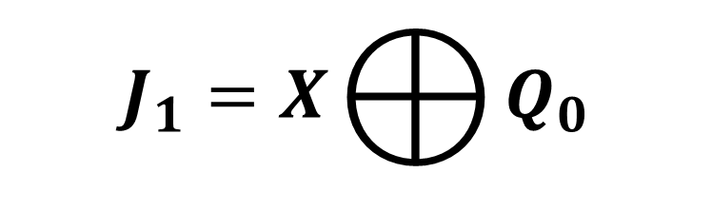

SIMPLIFICATION(K-MAP)
PRESENT STATE |  |  | JK FLIP FLOP INPUTS |  |  |  |  |  | JK FLIP FLOP INPUTS
 |  |  | X=0 |  |  |  |  |  | X=1
0 | 0 | 0 | 0 | X | 0 | X | 1 | X | 1 | X | 1 | X | 1 | X
0 | 0 | 1 | 0 | X | 1 | X | X | 1 | 0 | X | 0 | X | X | 1
0 | 1 | 0 | 0 | X | X | 0 | 1 | X | 0 | X | X | 1 | 1 | X
0 | 1 | 1 | 1 | X | X | 1 | X | 1 | 0 | X | X | 0 | X | 1
1 | 0 | 0 | X | 0 | 0 | X | 1 | X | X | 1 | 1 | X | 1 | X
1 | 0 | 1 | X | 0 | 1 | X | X | 1 | X | 0 | 0 | X | X | 1
1 | 1 | 0 | X | 0 | X | 0 | 1 | X | X | 0 | X | 1 | 1 | X
1 | 1 | 1 | X | 1 | X | 1 | X | 1 | X | 0 | X | 0 | X | 1
 |  | 00 | 01 | 11 | 10
 | 00 | 0 | 1 | X | X
 | 01 | 0 | 1 | X | X
 | 11 | 1 | 0 | X | X
 | 10 | 1 | 0 | X | X

Slide 22

SIMPLIFICATION(K-MAP)
PRESENT STATE |  |  | JK FLIP FLOP INPUTS |  |  |  |  |  | JK FLIP FLOP INPUTS
 |  |  | X=0 |  |  |  |  |  | X=1
0 | 0 | 0 | 0 | X | 0 | X | 1 | X | 1 | X | 1 | X | 1 | X
0 | 0 | 1 | 0 | X | 1 | X | X | 1 | 0 | X | 0 | X | X | 1
0 | 1 | 0 | 0 | X | X | 0 | 1 | X | 0 | X | X | 1 | 1 | X
0 | 1 | 1 | 1 | X | X | 1 | X | 1 | 0 | X | X | 0 | X | 1
1 | 0 | 0 | X | 0 | 0 | X | 1 | X | X | 1 | 1 | X | 1 | X
1 | 0 | 1 | X | 0 | 1 | X | X | 1 | X | 0 | 0 | X | X | 1
1 | 1 | 0 | X | 0 | X | 0 | 1 | X | X | 0 | X | 1 | 1 | X
1 | 1 | 1 | X | 1 | X | 1 | X | 1 | X | 0 | X | 0 | X | 1
 |  | 00 | 01 | 11 | 10
 | 00 | X | X | 1 | 0
 | 01 | X | X | 1 | 0
 | 11 | X | X | 0 | 1
 | 10 | X | X | 0 | 1

Slide 23
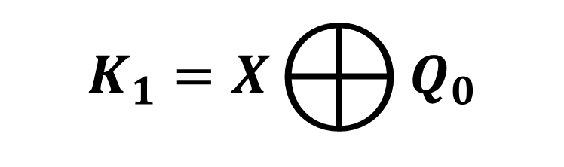

SIMPLIFICATION(K-MAP)
PRESENT STATE |  |  | JK FLIP FLOP INPUTS |  |  |  |  |  | JK FLIP FLOP INPUTS
 |  |  | X=0 |  |  |  |  |  | X=1
0 | 0 | 0 | 0 | X | 0 | X | 1 | X | 1 | X | 1 | X | 1 | X
0 | 0 | 1 | 0 | X | 1 | X | X | 1 | 0 | X | 0 | X | X | 1
0 | 1 | 0 | 0 | X | X | 0 | 1 | X | 0 | X | X | 1 | 1 | X
0 | 1 | 1 | 1 | X | X | 1 | X | 1 | 0 | X | X | 0 | X | 1
1 | 0 | 0 | X | 0 | 0 | X | 1 | X | X | 1 | 1 | X | 1 | X
1 | 0 | 1 | X | 0 | 1 | X | X | 1 | X | 0 | 0 | X | X | 1
1 | 1 | 0 | X | 0 | X | 0 | 1 | X | X | 0 | X | 1 | 1 | X
1 | 1 | 1 | X | 1 | X | 1 | X | 1 | X | 0 | X | 0 | X | 1
 |  | 00 | 01 | 11 | 10
 | 00 | X | X | 1 | 0
 | 01 | X | X | 1 | 0
 | 11 | X | X | 0 | 1
 | 10 | X | X | 0 | 1

Slide 24

SIMPLIFICATION(K-MAP)
PRESENT STATE |  |  | JK FLIP FLOP INPUTS |  |  |  |  |  | JK FLIP FLOP INPUTS
 |  |  | X=0 |  |  |  |  |  | X=1
0 | 0 | 0 | 0 | X | 0 | X | 1 | X | 1 | X | 1 | X | 1 | X
0 | 0 | 1 | 0 | X | 1 | X | X | 1 | 0 | X | 0 | X | X | 1
0 | 1 | 0 | 0 | X | X | 0 | 1 | X | 0 | X | X | 1 | 1 | X
0 | 1 | 1 | 1 | X | X | 1 | X | 1 | 0 | X | X | 0 | X | 1
1 | 0 | 0 | X | 0 | 0 | X | 1 | X | X | 1 | 1 | X | 1 | X
1 | 0 | 1 | X | 0 | 1 | X | X | 1 | X | 0 | 0 | X | X | 1
1 | 1 | 0 | X | 0 | X | 0 | 1 | X | X | 0 | X | 1 | 1 | X
1 | 1 | 1 | X | 1 | X | 1 | X | 1 | X | 0 | X | 0 | X | 1
 |  | 00 | 01 | 11 | 10
 | 00 | 1 | X | X | 1
 | 01 | 1 | X | X | 1
 | 11 | 1 | X | X | 1
 | 10 | 1 | X | X | 1

Slide 25

SIMPLIFICATION(K-MAP)
PRESENT STATE |  |  | JK FLIP FLOP INPUTS |  |  |  |  |  | JK FLIP FLOP INPUTS
 |  |  | X=0 |  |  |  |  |  | X=1
0 | 0 | 0 | 0 | X | 0 | X | 1 | X | 1 | X | 1 | X | 1 | X
0 | 0 | 1 | 0 | X | 1 | X | X | 1 | 0 | X | 0 | X | X | 1
0 | 1 | 0 | 0 | X | X | 0 | 1 | X | 0 | X | X | 1 | 1 | X
0 | 1 | 1 | 1 | X | X | 1 | X | 1 | 0 | X | X | 0 | X | 1
1 | 0 | 0 | X | 0 | 0 | X | 1 | X | X | 1 | 1 | X | 1 | X
1 | 0 | 1 | X | 0 | 1 | X | X | 1 | X | 0 | 0 | X | X | 1
1 | 1 | 0 | X | 0 | X | 0 | 1 | X | X | 0 | X | 1 | 1 | X
1 | 1 | 1 | X | 1 | X | 1 | X | 1 | X | 0 | X | 0 | X | 1
 |  | 00 | 01 | 11 | 10
 | 00 | X | 1 | 1 | X
 | 01 | X | 1 | 1 | X
 | 11 | X | 1 | 1 | X
 | 10 | X | 1 | 1 | X

Slide 26
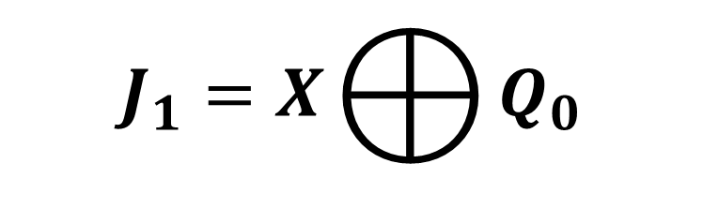
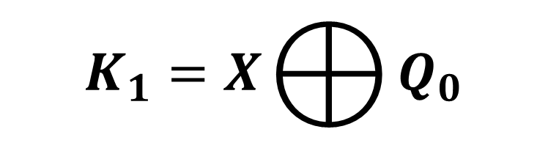


INPUT EQUATIONS

Slide 27
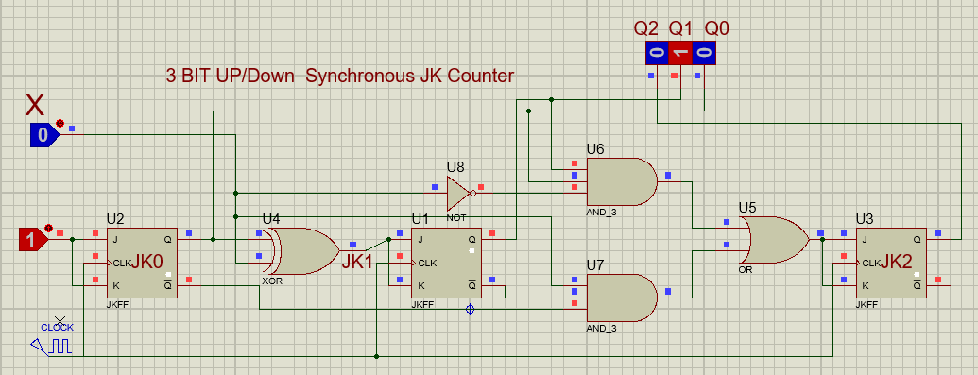
IMPLEMENTATIONS OF EQUATION

